Slide 1
Math for Algorithms
CLRS Chapter 3

Slide 2
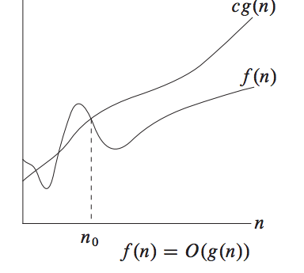
Big O

Slide 3
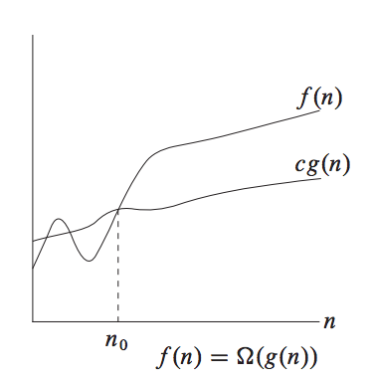
Omega

Slide 4
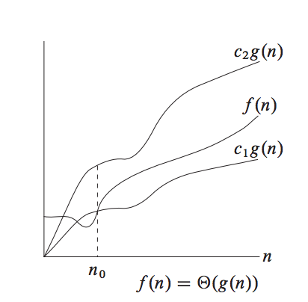
Theta

Slide 5

little O

Slide 6
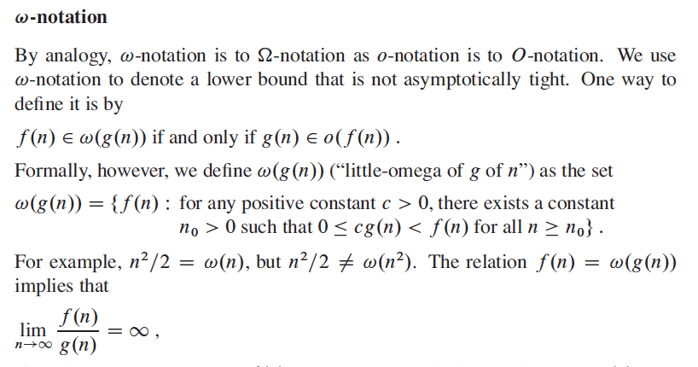
little omega

Slide 7

Transitivity

Slide 8
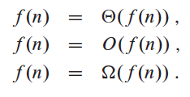
reflexivity

Slide 9
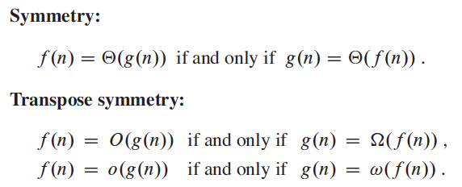
Symmetries

Slide 10
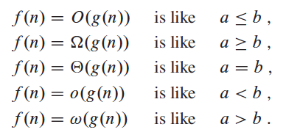
Analogies

Slide 11

Monotonicity

Slide 12

Floors and ceilings

Slide 13

Modulo

Slide 14
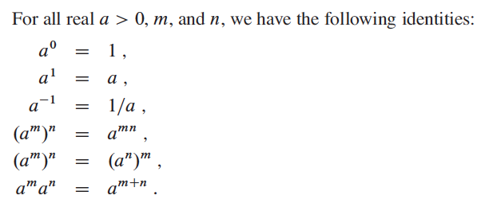
Exponentials

Slide 15

Logarithms 1

Slide 16
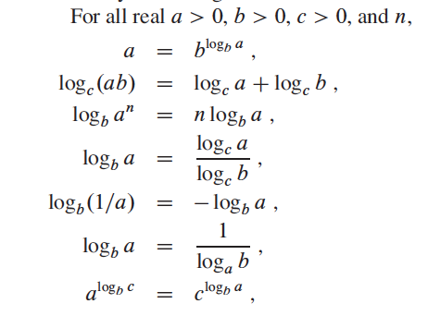
Logarithms 2

Slide 17

polylogarithmically bounded?

Slide 18
Factorials and Fibonacci

